Slide 1
Connected Device Studio Skill Transfer Workshop
Kevin Kao | Walker Lin | Andy Li
Microsoft IoT Innovation Center

Slide 2
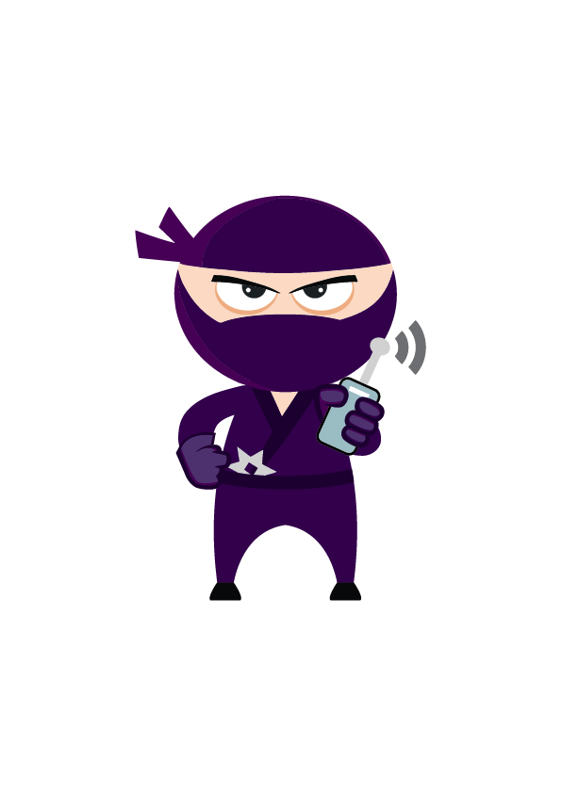
Content
Section 1 (4 hours)
Deploy Azure Services
Deploy DB and Data
Deploy API Service, Admin and SuperAdmin
Deploy Backend Tasks
First Company Onboarding
Remote Monitoring
Section 2 (4 ~6 hours)
DB Schema Overview
API Service (EF, Authentication and Class Model)
Admin & SuperAdmin (MVC and Call Flow)
Toolkit Device SDK & IoT Hub Receiver
Signal R & Message
Section 3 (4 hours)
Service Bus & OpsInfra, OpsAlarm, RoutineTask
Document DB
Service Fabric
Log & Operation and Trouble Shooting
Section 4 (4 hours)
How to Add New API
How to Add New Widget
How to Setup Staging Env

Slide 3
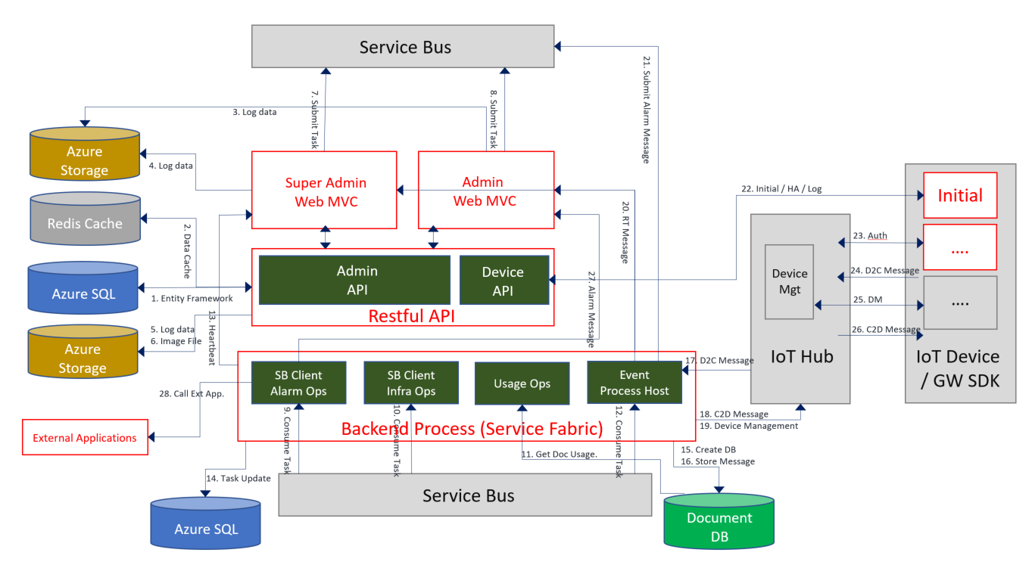
Architecture

Slide 4
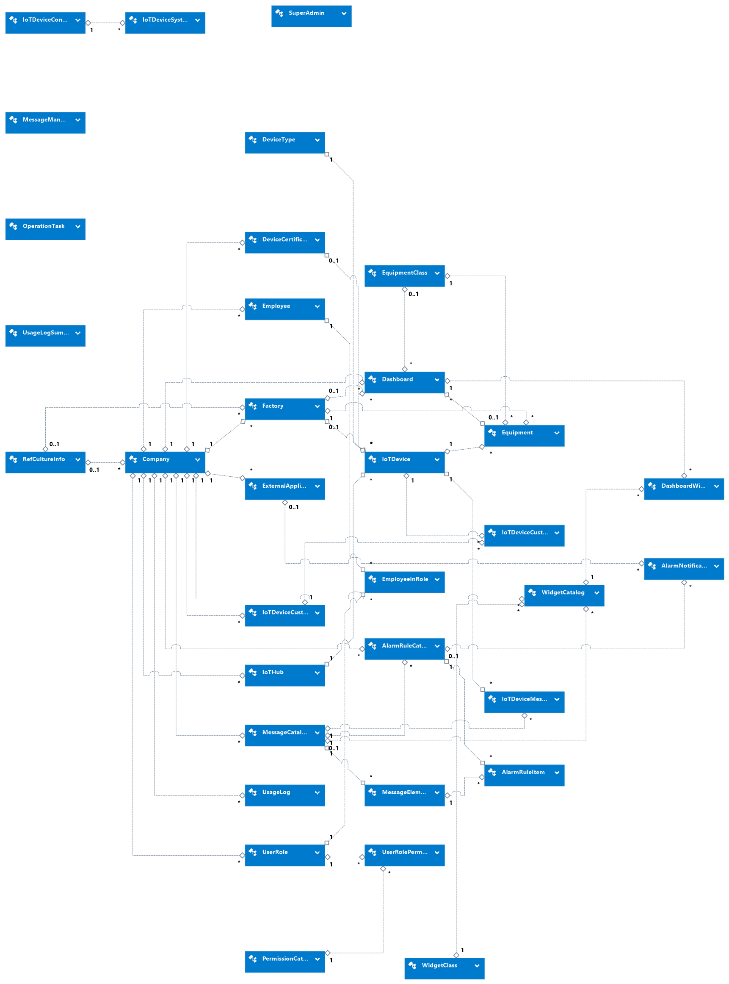
DB Schema Overview
31 Tables
1 View (UsageLogSumByDay)
5 Triggers

Slide 5
DB Schema – Core Entities
Company & Id
Employee & Id
Employee Email: Unique
Factory & Id
Equipment & Id
IoT Hub & IoTHubAlias
IoT Device & IoTHubDeviceId
Company
Employee
Factory
IoT Hub
Equipment
IoT Device

Slide 6
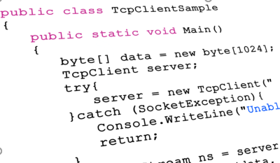
DB Schema – Employee and UserGroup
Role-based Access Control
EmployeeInRole:
Employ NxN UserRole
UserRolePermission:
UserRole NxN Permission
Permission Id maps on code level
Company
Employee
UserRole
Employee
InRole
UserRole
Permission
Permission
Catalog

Slide 7
DB Schema – IoT Device & Message
Device Certificate: IoT Device authenticate with IoT Hub by X.509 certificate
Device Type: Device or Gateway
IoTDeviceMessageCatalog:
IoTDevice NxN Message Catalog
IoT Device Configuration
IoT Hub
Device
Certificate
Factory
IoT Device
Device
Type
Company
IoTDevice
Message
Catalog
Equipment
IoTDevice
Customized
Configuration
Message
Element
Message
Catalog
IoTDevice
Configuration

Slide 8
DB Schema – Widget & Dashboard
Widget Class: Key and Level
- company | factory | equipment
Widget Catalog:
- companyId
- level: company, factory, equipment
- widget class key
- messageId: only with equipment level
- context: { … }
Dashboard: Id and DashboardType
- companyId
- company | factory | equipClass | equipment
DashboardWidgets:
Dashboard NxN WidgetCatalog
Factory
Equip Class
Equipment
Widget Class
Dashboard
Company
Dashboard
Widgets
Widget Catalog

Slide 9
DB Schema – Alarm Rule & Action
Message
Element
Alarm Rule Catalog
- activeFlag
Alarm Rule Item:
External Application
Alarm Notification:
Alarm Rule Catalog NxN External Application
Message
Catalog
Company
AlarmRule
Catalog
AlarmRule
Item
Alarm
Notification
External
Application

Slide 10
DB Schema – Others Tables
Message Mandatory Element
Message Mandatory Element: Define mandatory message element for master message
Operation Task: Backend task execution result.
RefCultureInfo: For globalization and localization
Super Admin: Super Admin account
Usage Log: Store factory #, equipment # and message # by company and by each day.
Operation Task
RefCultureInfo
Super Admin
Usage Log

Slide 11
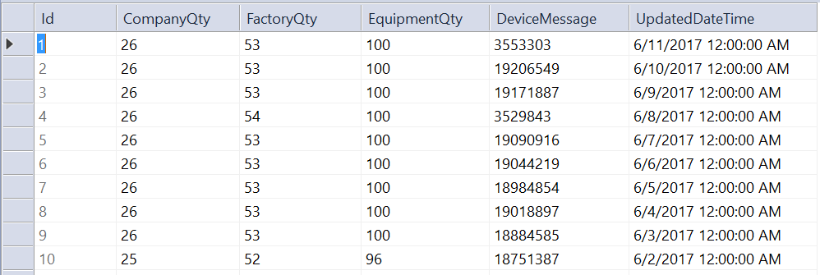
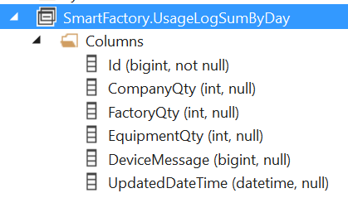
DB View: UsageLogSumByDay
CREATE VIEW SmartFactory.UsageLogSumByDay
AS select ISNULL(ROW_NUMBER() OVER(ORDER BY MIN(Id) DESC), -1) AS Id, COUNT(*) as CompanyQty, sum(FactoryQty) as FactoryQty, sum(EquipmentQty) as EquipmentQty, sum(DeviceMessage) as DeviceMessage, dateadd(DAY,0, datediff(day,0, UpdatedAt)) as UpdatedDateTime from SmartFactory.UsageLog group by dateadd(DAY,0, datediff(day,0, UpdatedAt))

Slide 12
DB Trigger: after Insert Company
CREATE TRIGGER SmartFactory.TR_Company on SmartFactory.Company AFTER Insert
AS
Begin
insert into SmartFactory.UserRole(CompanyID, Name) select ID, 'Default' from inserted
insert into SmartFactory.WidgetCatalog(CompanyID, ......where B.Level='company’
insert into SmartFactory.WidgetCatalog(CompanyID, ......where B.Level='factory’
insert into SmartFactory.Dashboard(CompanyID, DashboardType) select ID, 'company' ......
End
Create ‘default’ UserRole
Create company level dashboard
Create company level widgetCatalog
Create factory level widgeCatalog

Slide 13
DB Trigger: after Insert Factory
CREATE TRIGGER SmartFactory.TR_Factory on SmartFactory.Factory AFTER Insert
AS
Begin
insert into SmartFactory.Dashboard(CompanyID , DashboardType, FactoryID) select A.CompanyId,
'factory', A.Id from inserted A
End
Create factory level dashboard

Slide 14
DB Trigger: after Insert Dashboard
Create TRIGGER SmartFactory.TR_CompanyDashboardWidgets on SmartFactory.Dashboard AFTER Insert
AS
Begin
insert into SmartFactory.DashboardWidgets(DashboardID, WidgetCatalogID, RowNo, ColumnSeq, WidthSpace, HeightPixel) select A.ID, B.ID, 0, 0, 4, 160 from inserted A, SmartFactory.WidgetCatalog B Where B.CompanyID = A.CompanyID AND B.Level = A.DashboardType
End
Create company and factory level widgets from WidgetCatalog to DashboardWidgets after company and factory level dashboard be created.

Slide 15
DB Trigger: after delete Factory
CREATE TRIGGER SmartFactory.TR_Factory_Delete on SmartFactory.Factory AFTER Update
AS
Begin
Declare @DeletedFlag bit
Declare @FactoryId Int
Declare @BoardId Int
Select @DeletedFlag = Inserted.DeletedFlag from Inserted
if (@DeletedFlag=1)
Begin
Select @FactoryId = Inserted.Id from Inserted
Select @BoardId = A.Id from SmartFactory.Dashboard A where A.FactoryID=@FactoryId and A.DashboardType='factory’
delete SmartFactory.DashboardWidgets where DashboardID = @BoardId
delete SmartFactory.Dashboard where Id = @BoardId
End
End
Remove Factory Dashboard
Remove Factory DashboardWidgets

Slide 16
DB Trigger: after insert MessageCatalog
Create TRIGGER SmartFactory.TR_MessageSFMandatoryElement on SmartFactory.MessageCatalog AFTER Insert
AS
Begin
DECLARE @ID int, @ChildMessage bit
SET @ID = (SELECT ID FROM inserted)
SET @ChildMessage = (SELECT ChildMessageFlag FROM inserted)
IF (@ChildMessage = 0)
BEGIN
insert into SmartFactory.MessageElement (MessageCatalogID, ElementName, ElementDataType,
MandatoryFlag, SFMandatoryFlag)
select @ID, ElementName, ElementDataType, MandatoryFlag, MandatoryFlag from
SmartFactory.MessageMandatoryElementDef;
End
End
Create mandatory message element for new created master message

Slide 17
Section 2 DB End
Kevin Kao | Walker Lin | Andy Li
Microsoft IoT Innovation Center

